Slide 1


Gesture Controlled Robot
by,
Laxuman Pradhan (20120144)
Aiman Jalil (20120308)
Ashwin Bordoloi(20120392)
Under the guidance of
Mr. Saurav Paul
(Assistant Professor II ,SMIT)
SIKKIM MANIPAL INSTITUTE OF TECHNOLOGY
MAJITAR RANGPO, EAST SIKKIM 737136
12

Slide 2
CONTENTS
ABSTRACT
INTRODUCTION
LITERATURE SURVEY
PROBLEM DEFINITION
SOLUTION STRATEGY
DESIGN
PROGRESS TILL DATE
GANTT CHART
SCREENSHOTS
REFERENCES
11

Slide 3
ABSTRACT
Limit usage of peripheral devices
This can be done by interpreting hand gestures
Recognize patterns, generate movements
Give output to the robot
Perform action
10

Slide 4
INTRODUCTION
Using gestures to provide a more natural way of controlling robotic systems
Passage of data signals to robot using either an accelerometer or via image processing
Program compiled using an Arduino microcontroller
Image processed using MATLAB
9

Slide 5
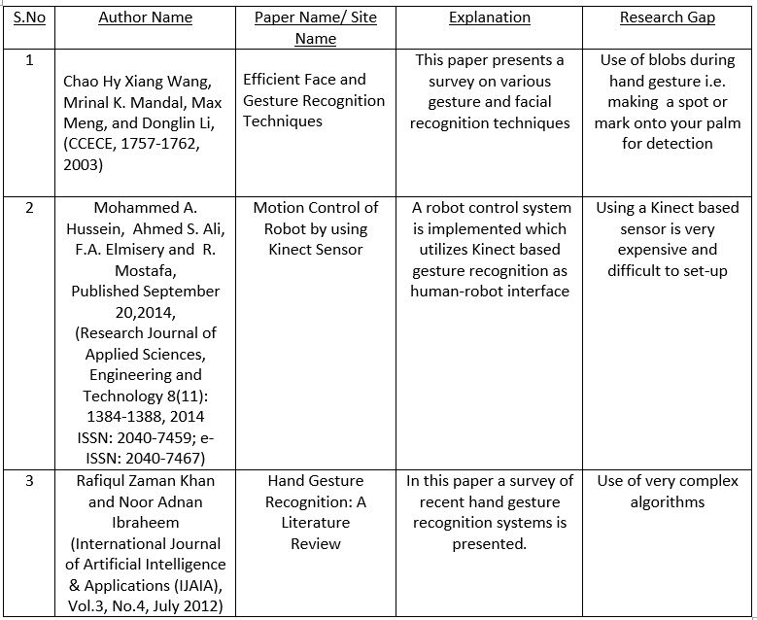
LITERATURE SURVEY
8

Slide 6
PROBLEM DEFINITION
High Cost of peripherals, associated with the control of equipment.
Maintaining a background database
Hand gesture recognition using hand accessories/props.
7

Slide 7
SOLUTION STRATEGY
Capture images of gestures
Process Gesture input
Command Signal Generation
Navigation of Robot in specified direction
Passing Signal to Robot
6

Slide 8
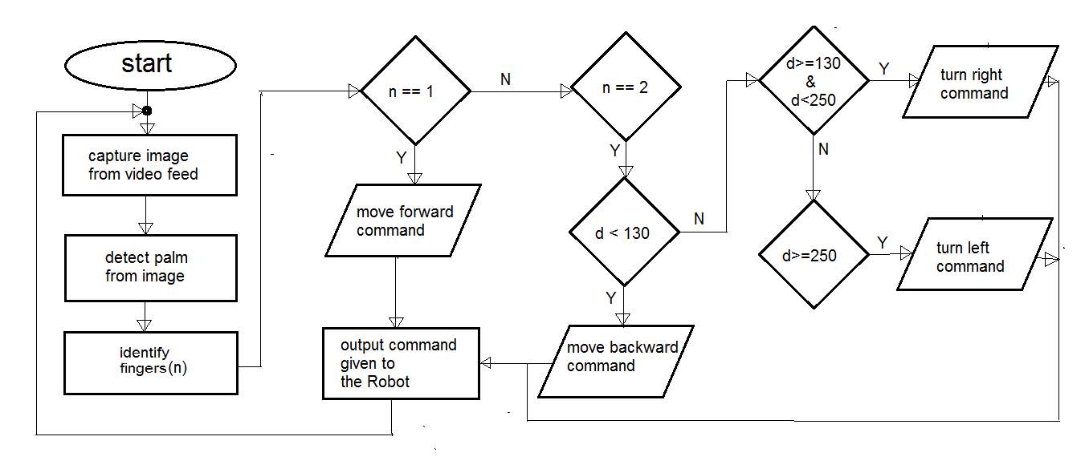
IMPLEMENTATION: FLOWCHART
5

Slide 9
PROGRESS TILL DATE
Hand palm recognition and counting of fingers.
recognizing different gestures
Sending final output command based on the gesture
Initial interfacing the MATLAB code with an Arduino micro-controller
4

Slide 10
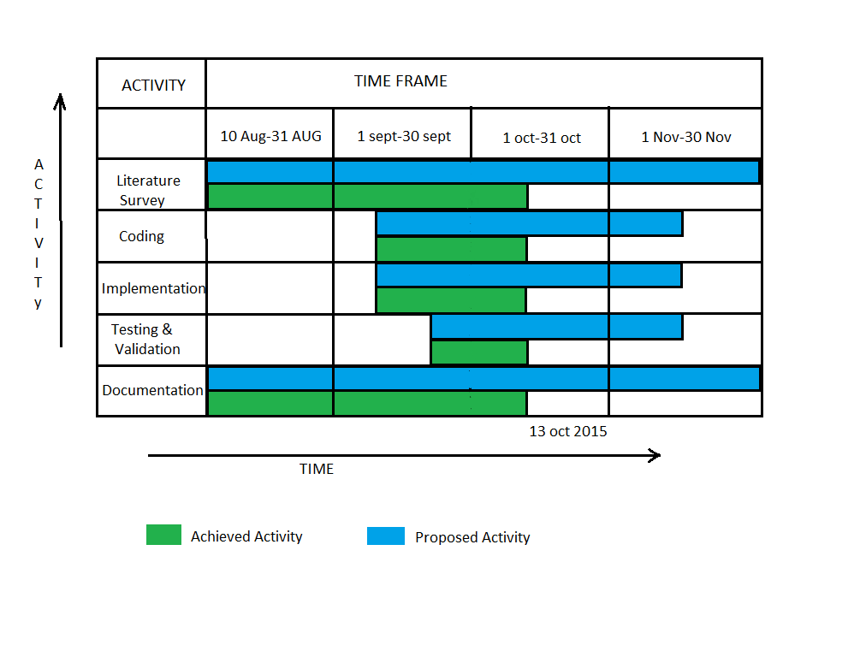
GANTT CHART
3

Slide 11
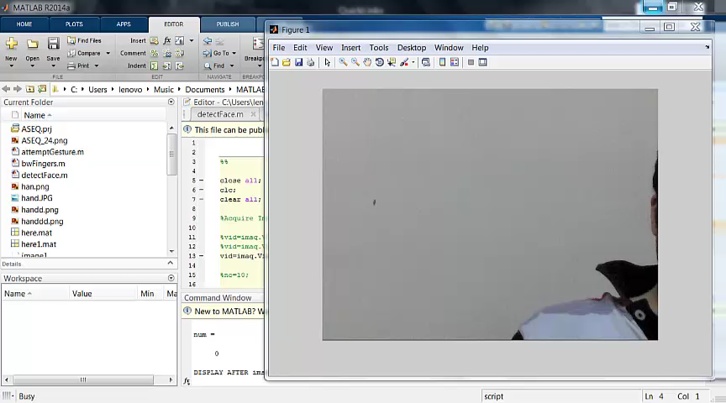
SCREENSHOTS
2

Slide 12
REFERENCES
Efficient Face and Gesture Recognition Techniques- Paper by Chao Hy Xiang Wang, Mrinal K. Mandal, Max Meng, and Donglin Li
Motion Control of Robot by using Kinect Sensor- Paper by Mohammed A. Hussein, Ahmed S. Ali, F.A. Elmisery and R. Mostafa
Hand Gesture Recognition: A Literature Review- Paper by Rafiqul Zaman Khan and Noor Adnan Ibraheem
Arduino: http://www.arduino.cc/en/Guide/HomePage
http://www.e-yantra.org/home/projects-wiki/item/180-gesture-controlled-robot-using-firebirdv-and-kinect
http://ieeexplore.ieee.org
http://luckylarry.co.uk/arduino-projects/control-a-dc-motor-with-arduino-and-l293d-chip/
1

Slide 13
Thank You

